Slide 1
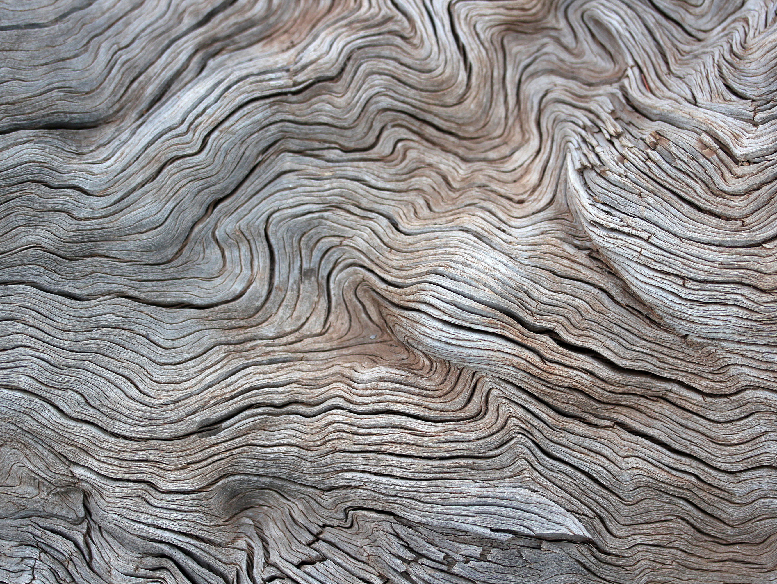
PrimeBot Hotel Assitant By- Kumar Siddharth Nirmal

Slide 2

Problem Statement & Objective
Users face difficulty finding relevant hotel options using traditional filters.
Objective: Create a conversational assistant that understands natural queries

Slide 3

System Architecture
Frontend: HTML/CSS-based chat UI
Backend: Flask app with modular Python scripts
NLP Engine: OpenAI GPT API (natural query parsing)
Data: CSV file with hotel details and coordinates
Output: Recommendations + Map location view

Slide 4

Key Features & Value
Natural language query handling
Personalized hotel filtering
Google Maps-style visual results
Extendable to RAG, personalization, or APIs
Simple to deploy and customize

Slide 5

Demo & Source Code
Visit: http://localhost:5055 (local deployment)
GitHub Repo: https://github.com/SidNirmal-DS/Prime-Bot
Architecture and folder layout images available
Test cases included in repo
OpenAI GPT key securely loaded via .env

